Slide 1
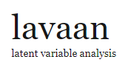
Mediation and moderation with
A powerful SEM tool
A translator

Slide 2

The basics

Slide 3
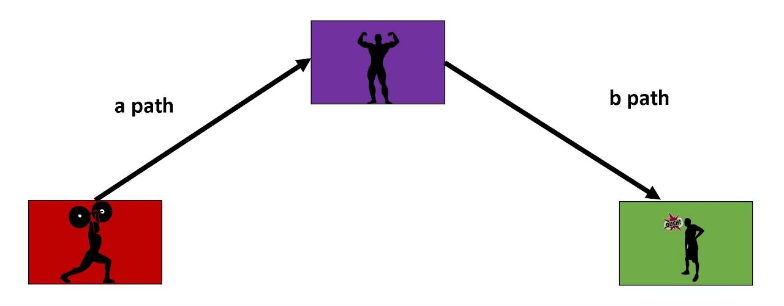
Mediation
Combine regression models to find:
Indirect effect
Direct effect
Total effect
+ Significance
Two preconditions:
M ~ IV
DV ~ M + IV
3

Slide 4
Example

Slide 5
Intergroup contact and bystander intervention
Are White students who have had more positive contact with Black people more likely to intervene when they witness a racial slur?
Is this mediated by better attitudes towards Black people?

Slide 6
Your Turn 1
In 04-mediation-and-moderation.Rmd:
Import and prepare the contact data (code provided, but have a look)
glimpse() the dataset
Run the lm() models to test the preconditions
03:00
6

Slide 7
A lavaan model
Set of formulae describing a path model.
We need:
Regression formulae
e.g., fitness ~ exercise
but: name important parameters
fitness ~ a * exercise
Calculated parameters:
e.g., indirect := a*b

Slide 8
Your Turn 2
Insert the model code into the blank
M ~ a * IV
DV ~ b * M + direct * IV
indirect := a * b
total := direct + indirect
Run the chunk and interpret the output (hint: start from the bottom)
04:00
8
Notes:
affect_black ~ a * positive_contact
bystander_intervention ~ b * affect_black + direct * positive_contact
indirect := a * b
total := direct + indirect

Slide 9
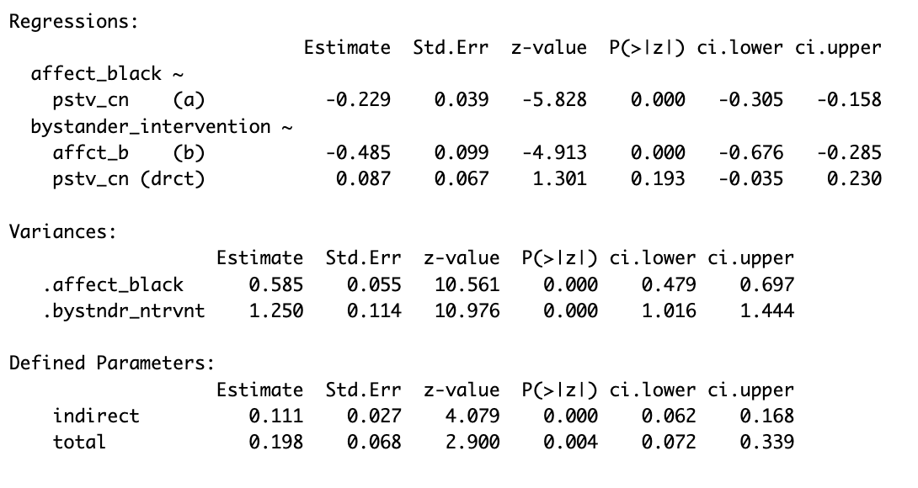
Result
sem(model_code, contact, bootstrap = 1000) %>% summary(ci = TRUE)
Can rely on confidence interval for indirect effect (like PROCESS) – or report bootstrapped p-value
ALWAYS use set.seed(your_favorite_number) before bootstrapping for reproducibility
9

Slide 10
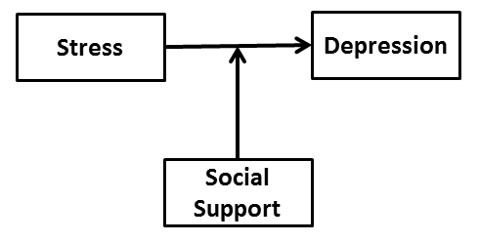
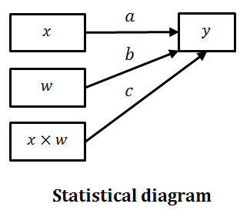
Moderation
An interpretation of an interaction term
lm(depression ~ stress * social_support, data)
10

Slide 11

Your Turn 3
Test whether education moderates the relationship between health and happiness:
Run the lm() model.
Visualise it with plot_model()
03:00
11

Slide 12
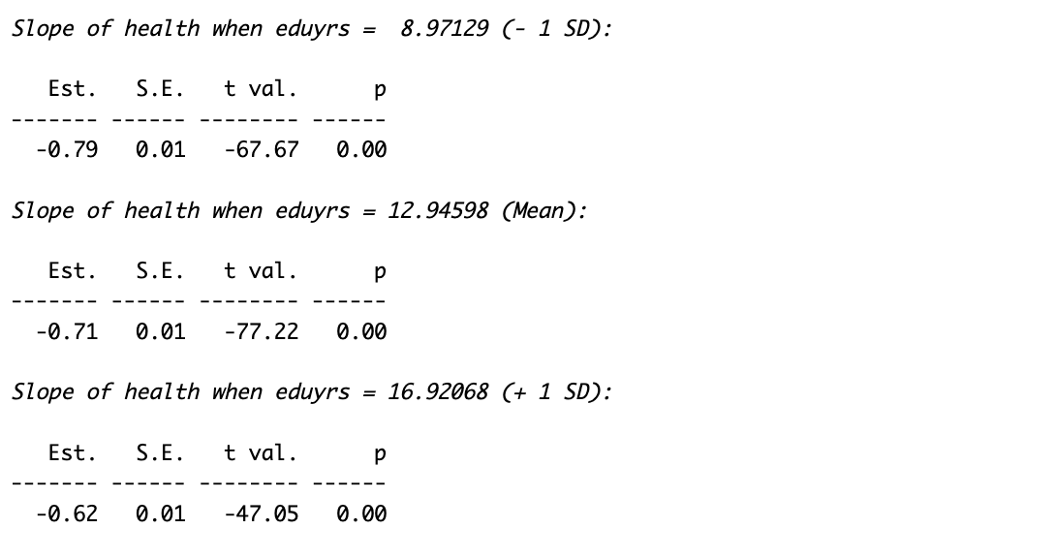
To report
interactions::sim_slopes(mod_mod, pred = "health", modx = "eduyrs")

Slide 13
Doing this in lavaan
#Regression model
happy ~ a * health + b * eduyrs + c * health: eduyrs
#Ingredients for simple slopes
eduyrs ~ M_ eduyrs * 1
eduyrs ~~ var_eduyrs * eduyrs
#Simple slopes
SDbelow := a + c * (M_eduyrs - sqrt(var_eduyrs))
Mean := a + c * M_eduyrs
SDabove:= a + c * (M_eduyrs + sqrt(var_eduyrs))
Your Turn 4
Understand and run this
06:00
13

Slide 14
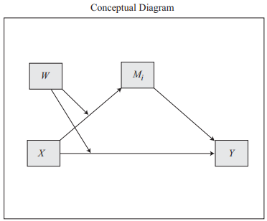
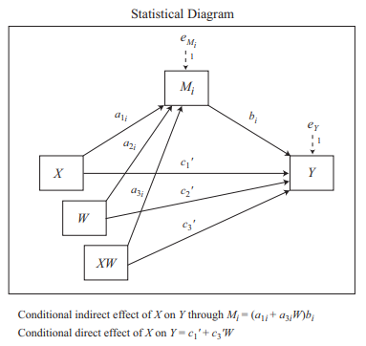
Moderated mediation
We have all the building blocks to build models in lavaan … e.g., Process Model 8 (full set of diagrams)
→ BUT quite a lot of code

Slide 15
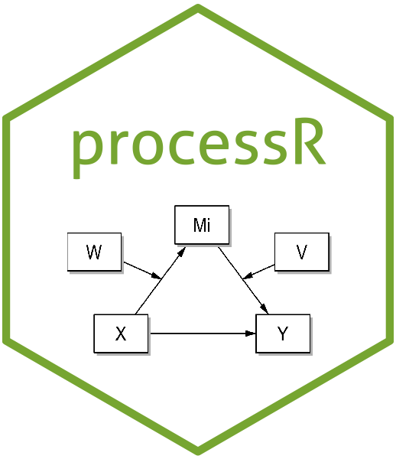
processR
Attempt to translate PROCESS into R
Package not very intuitive – but helpful web app to extract lavaan code and diagrams (or run full analyses)

Slide 16
Your Turn 5 Bringing it all together
Extract the code for a Model 8 from the processR app
Adapt it to test whether the mediation from the start is moderated by gender (note that the decomposition is no longer about M and SD then)
10:00
16

Slide 17

Alternatives
PROCESS for R
- YouTube tutorial series
Mediation package
… but: lavaan is a great multi-purpose tool (CFA, SEM, FIML-estimation)
Notes:
But: lavaan is po

Slide 18
Mediation and moderation with
A powerful SEM tool
A translator

